Slide 1
Linear Regression

Slide 2
Outline
Simple model of linear regression
Metrics for measuring the error of a model
Concept of an error surface

Slide 3
Error based learning models
Parameterized prediction model is initialized with a set of random parameters, and an error function is used to judge how well this initial model performs when making predictions for instances in a training dataset.
Based on the value of the error function, the parameters are iteratively adjusted to create a more and more accurate model.

Slide 4
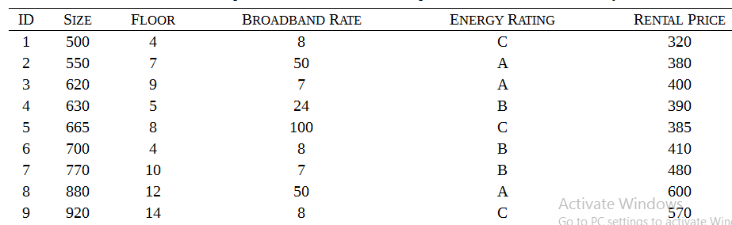
Introduction to Linear Regression
Simple dataset with 4 features to determine rent. (Size - sq. ft., broadband rate - Mbps, Energy rating A- most efficient, rental price per seat)

Slide 5
Linear Regression - one variable
Make a scatterplot with size on x-axis and rental cost on y axis
Fit a straight line using the equation y= mx + c to the plot
What are the values of m and c?
What is the rate of increase in price per sq. ft increase in area?
What is the cost of an office of area 720 sq ft?
This is a uni-variate simple linear regression model
Notes:
6.47+.62*size
where m is the slope of the line, and b is known as the y-intercept of the line (i.e., the position at which the line meets the vertical axis when the value of x is set to zero). The equation of a line predicts a y value for every x value given the slope and the y-intercept, and we can use this simple model to capture the relationship between two features such as SIZE and RENTAL PRICE.

Slide 6
Simple linear regression
Simple linear regression model can be rewritten as
M_{w} (d) = w[0] + w[1]*d[1]
w is the vector 〈w[0], w[1]〉,
w[0] and w[1] are referred to as weights
d is an instance defined by a single descriptive feature d[1],
M_{w} (d) is the prediction output by the model for the instance d

Slide 7
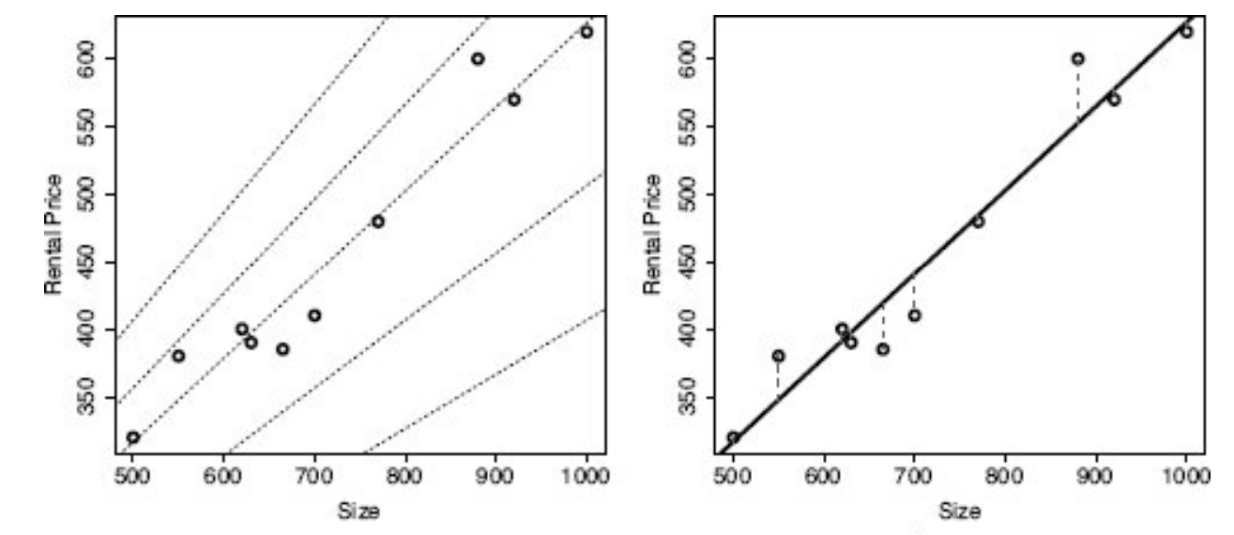

Simple linear regression- Error function
The key is determining the optimal values for the weights in the model.
A set of weights that capture this relationship well are said to fit the training data
We define an error function to measure the error between the predictions a model makes and the actual target values for each instance in the training data
i=n
L(M_{w},D) = (t_{i} - M_{w} (d_{i}))²
i=1
Notes:
Make a table with the following columns - size, price, predicted value, error, square error. Compute the formula and get the value of the error. Try the other values of w₁ to get a feel for other values of error

Slide 8
Simple linear regression- Error function
In the formula:
d_{i} represents the descriptive features of a single training instance
(d_{i} , t_{i}) is the set of n training instances, where the training dataset is composed of n training instances
w(d_{i}) is the prediction made by a model w for one instance
i=n
L(M_{w},D) = (t_{i} - M_{w} (d_{i}))²
i=1

Slide 9
Error surfaces
For every possible combination of weights, w[0] and w[1], there is a corresponding sum of squared errors value
We can think about all these error values joined to make a surface defined by the weight combinations
Each pair of weights w[0] and w[1] defines a point on the x-y plane, and the sum of squared errors for the model using these weights determines the height of the error surface above the x-y plane for that pair of weights
The x-y plane is known as a weight space, and the surface is known as an error surface
The model that best fits the training data is the model corresponding to the lowest point on the error surface.

Slide 10
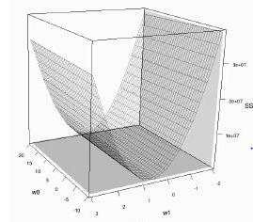
Error surface
In real life, not practical to use the brute force approach we tried for our small example
We need a more efficient way to find the best combination of weights.
For prediction problems like that posed by the office rentals dataset, the associated error surfaces are convex, and they have a global minimum.
Convex => the error surfaces are shaped like a bowl
Global minimum => there is a unique set of optimal weights with the lowest sum of squared errors on the surfaces
Notes:
This is because we are able to fit a linear model

Slide 11
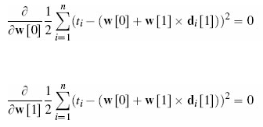
Finding the point of minimum error
The optimal weights occur at the point where the partial derivatives of the error surface with respect to w[0] and w[1] are equal to 0
The partial derivatives of the error surface with respect to w[0] and w[1] measure the slope of the error surface at the point w[0] and w[1]
The coordinates of the point at the global minimum define the weights for the prediction model with the lowest sum of squared errors on the dataset

Slide 12
Gradient Descent
Gradient descent algorithm is a guided search approach to finding the global minimum
One of the most important algorithms in machine learning and can be used for many different purposes
Gradient descent can be used to find the optimal weights for linear regression models that handle multiple descriptive features: multivariable linear regression models

Slide 13
Multi-variable Linear Regression
M_{w} (d) = w[0]d[0] + w[1]*d[1]+.........+ w[m]*d[m] - d[0] =1 is a dummy feature
d is a vector of m descriptive features, d [1] … d [m], and w[0] … w [m] are (m + 1) weights
In vector notation
L(M_{w},D) = w[i]*d[i] = w.d
For our multi-variable rental calculation problem,
Rental price = w[0] + w[1]*size + w[2]*floor +w[3]*broadband
Best fit weights are: w[0] = −0.1513, w[1] = 0.6270, w[2] = −0.1781, and w [3] = 0.0714
i=m
i=0
Notes:
M1=w0d0+w1d1+w2d2

Slide 14
Gradient Descent
We will see how we arrive at these weights:
select a random point within the weight space (i.e., assign a random value within some sensible range to each weight in the multivariable linear regression
each weight is iteratively adjusted by a small amount based on the error in the predictions made by the current candidate model so as to generate subsequently more and more accurate candidate models
i.e., for each weight a small adjustment is made by adding a small value, called a delta value
learning rate, α, determines the size of the adjustments made to weights at each iteration of the algorithm
This is called the Ordinary Least Squares

Slide 15
Gradient descent

